Slide 1
Advanced Programming
Module Project
Module: Web Development Using Platforms
Start Date : 14 November 2022
End Date : 16 November 2022
Submission Date : 16 November 2022
Learner Name : Ida Bagus Ketut Yoghantara
Enrollment ID : BDSE04-0322
Presentation Date :

Slide 2
Contents
Contents
S. No. | Description
01 | List of software used
02 | OO Paradigm
03 | Class Relationships
04 | Class Diagram
05 | Developing Triple A portlet
06 | Customer Management Portlet
07 | Design Patterns

Slide 3
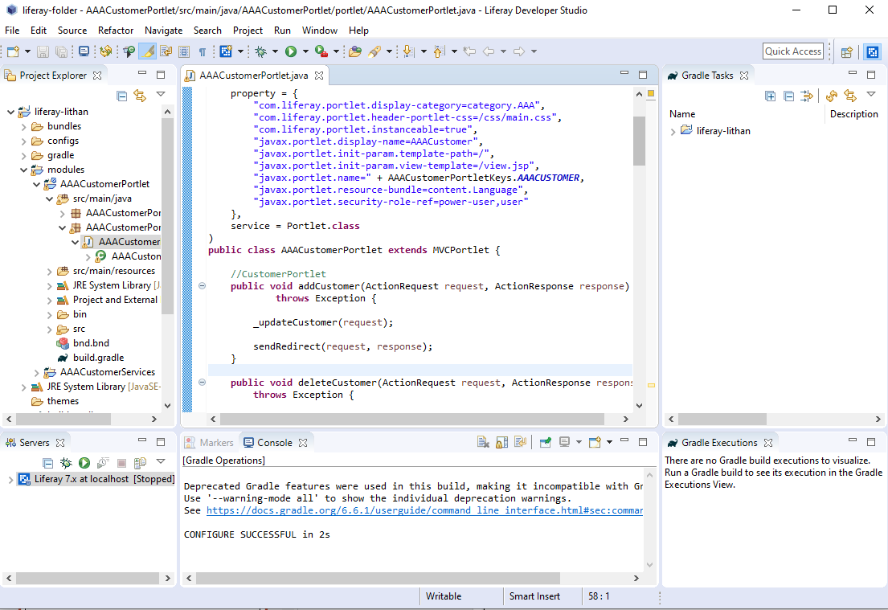
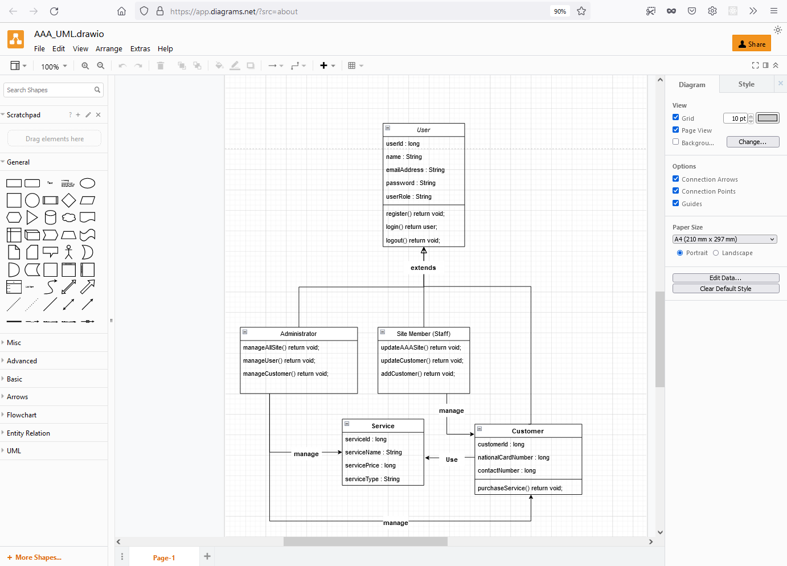
1. List of software used
Liferay IDE
Diagram.net

Slide 4
2. OO Paradigm
Object Oriented Programming
Object Oriented Programming or in short OOP is one of the programming paradigms which oriented to object. Then what its purpose? OOP aims to facilitate the development of a program. It has variables and functions wrapped into objects or classes. Both can interact with each other to form a program.
Main Structure
Classes are responsible for collecting procedures/functions and variables in one place. Class is a blueprint of an object or template for creating objects. Class represented object that will be created. So naming Class should be appropriate for object.
Objects are instances of a class created with specifically defined data. Objects can correspond to real-world objects or an abstract entity. When class is defined initially, the description is the only object that is defined.
Attributes are part of a class that is still closely related to that class. Attributes can also be referred to as properties or properties of a class.
Method role describes how an attribute act. The role in question is in the form of behavior that can be described by a method. Additionally, the subroutines contained in an object are called instance methods. Programmers use methods for reusability or keeping functionality encapsulated inside one object at a time.

Slide 5
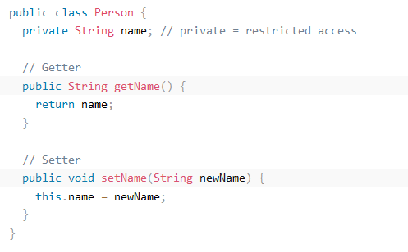
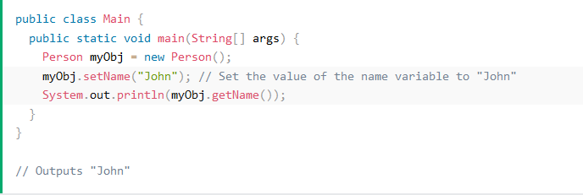
2. OO Paradigm
Characteristics of Object Oriented Programming Paradigm
Encapsulation Encapsulation is defined as the wrapping up of data under a single unit. It is the mechanism that binds together code and the data it manipulates. Another way to think about encapsulation is, that it is a protective shield that prevents the data from being accessed by the code outside this shield.

Slide 6
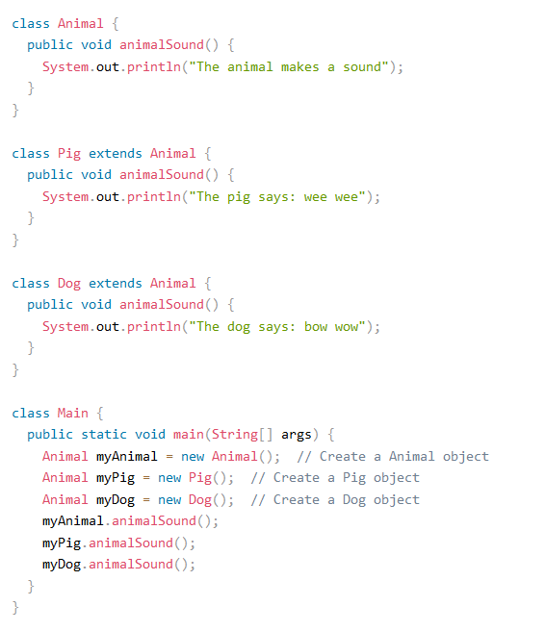
2. OO Paradigm
Characteristics of Object Oriented Programming Paradigm
Polymorphism Polymorphism is the ability of an object to take on many forms. The most common use of polymorphism in OOP occurs when a parent class reference is used to refer to a child class object.

Slide 7
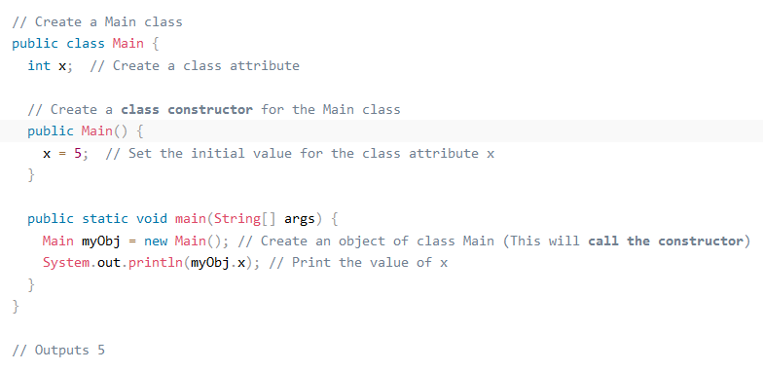
2. OO Paradigm
Characteristics of Object Oriented Programming Paradigm
Constructor Constructors in Java is a terminology been used to construct something in our programs. A constructor in Java is a special method that is used to initialize objects. The constructor is called when an object of a class is created. It can be used to set initial values for object attributes.

Slide 8
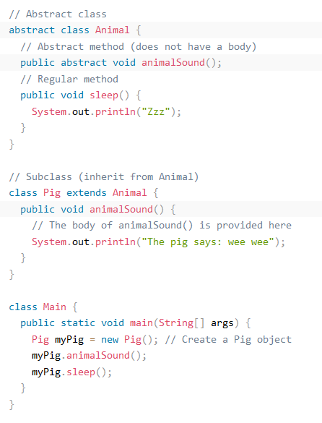
2. OO Paradigm
Characteristics of Object Oriented Programming Paradigm
Abstraction Abstraction is a process of hiding the implementation details and showing only functionality to the user. Another way, it shows only essential things to the user and hides the internal details.

Slide 9
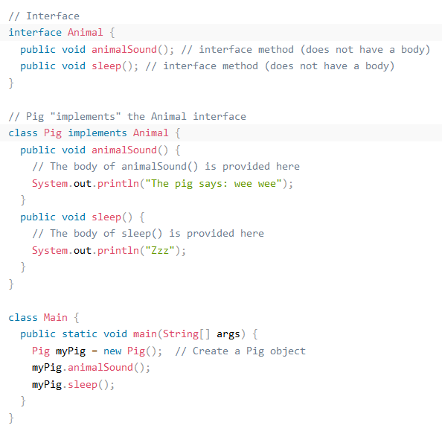
2. OO Paradigm
Characteristics of Object Oriented Programming Paradigm
Interface A totally abstract class is what an interface is. It consists of several abstract techniques (methods without a body). In Java, an interface is created with the interface keyword.

Slide 10
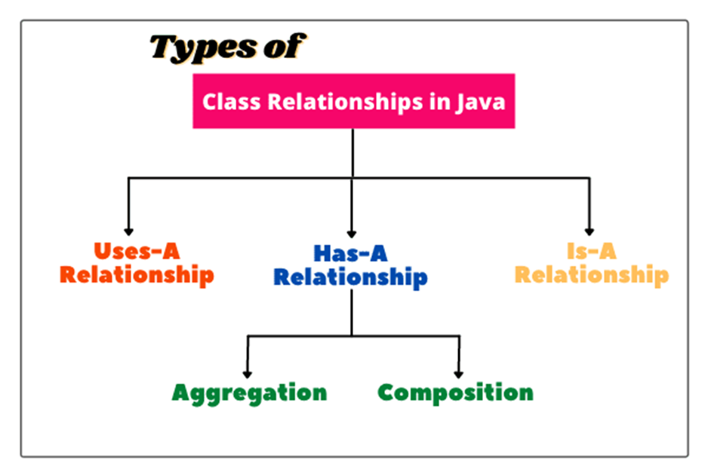
3. Class Relationships
Class Relationship
Class relationship define the special relationship among different kinds of classes. When we design a major application or program, we need to explore the relationships among classes. It helps us in a number of ways.
For example, in application we have classes with common methods. Then we can save effort by re-use the method from one super class. Suppose some classes are not related to each other we can assigned different programmers to implement each of them.
Types of Relationship

Slide 11
3. Class Relationships
Types of Relationship
Dependence (Uses-A)
When we create an object of a class inside a method of another class, this relationship is called dependence relationship in Java, or simply Uses-A relationship. In other words, when a method of a class uses an object of another class, it is called dependency in java. It is the most obvious and most general relationship in java.
If several classes of an application program depend on each other, then we say that the coupling between classes is high. It is a good programming practice to minimize the dependency between classes (i.e., coupling) because too many dependencies make an application program difficult to manage.
Inheritance (Is-A)
In Java, inheritance reflects the Is-a relationship. It makes a link between a more general (superclass) and a more specific (subclass) class (known as subclass). To put it another way, the Is-A relationship describes the relationship between two classes in which one class extends another. For instance, I mentioned abstract and interface, which both implement the concept of inheritance by establishing a relationship between the parent and child classes.
Realization
Last is Realization, it is a relationship between two elements in UML where one element specifies behavior and the other elements implements or execute, in other words, realize, that behavior. The relationship also often referred to as being between a supplier and client. Realization often being used on interface or a collection of operation.

Slide 12
3. Class Relationships
Types of Relationship
Association (Has-A)
When an object of one class is created as a data member inside another class, it is called Has-A relationship. In other words, a relationship in which an object of one class has a reference to an object of another class or another instance of the same class is called Has-A relationship in Java.
There following types of relationship under association:
Unidirectional Association
If an object associates with another object, it is called unidirectional association. It is also called one-way relationship or one-to-one relationship.
Bidirectional Association
When objects involved in association communicate with each other, it is called bidirectional association. In other words, an object can have associated with multiple objects and vice versa. This shows many-to-many relationship that could also be one-to-many and many-to-one relationship.

Slide 13
3. Class Relationships
Types of Relationship
Association (Has-A)
Has-A relationship itself has two branches:
Aggregation
It is an advanced form of unidirectional association which represent an ownership relationship between two class objects. When two aggregated objects have their own life cycle but one of the objects is the owner of Has-A relationship. Having their own relationship means destroying one objects will not affects another object.
Composition
While composition is the next level of aggregation, it is a more restrictive and strong form of aggregation. Composition differs from aggregation is that composition represent Has-A relationship that contains an object which cannot exist on its own.
In other words, child object does not have its own lifetime. If the parent object is destroyed, the child also got destroyed. Although it seems similar to inheritance, inheritance is defined as Is-A while composition is Has-A.

Slide 14
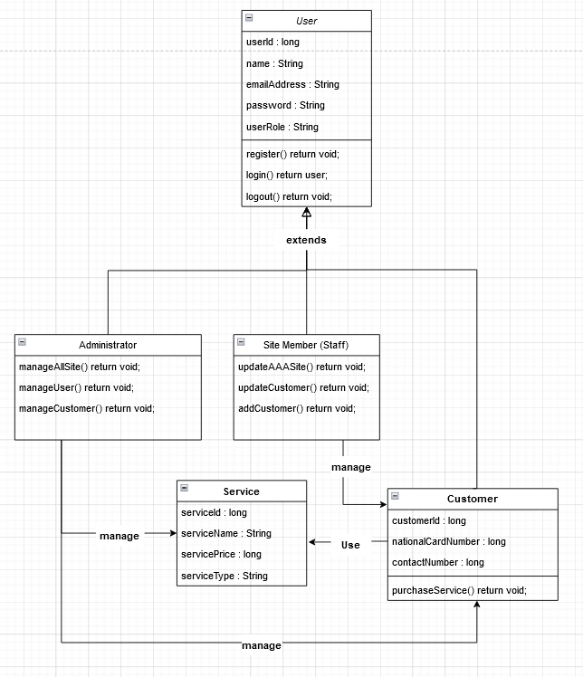
4. Class Diagram
Class Diagram based on project scenario using UML

Slide 15


5. Developing Triple A portal
Home
About Us

Slide 16

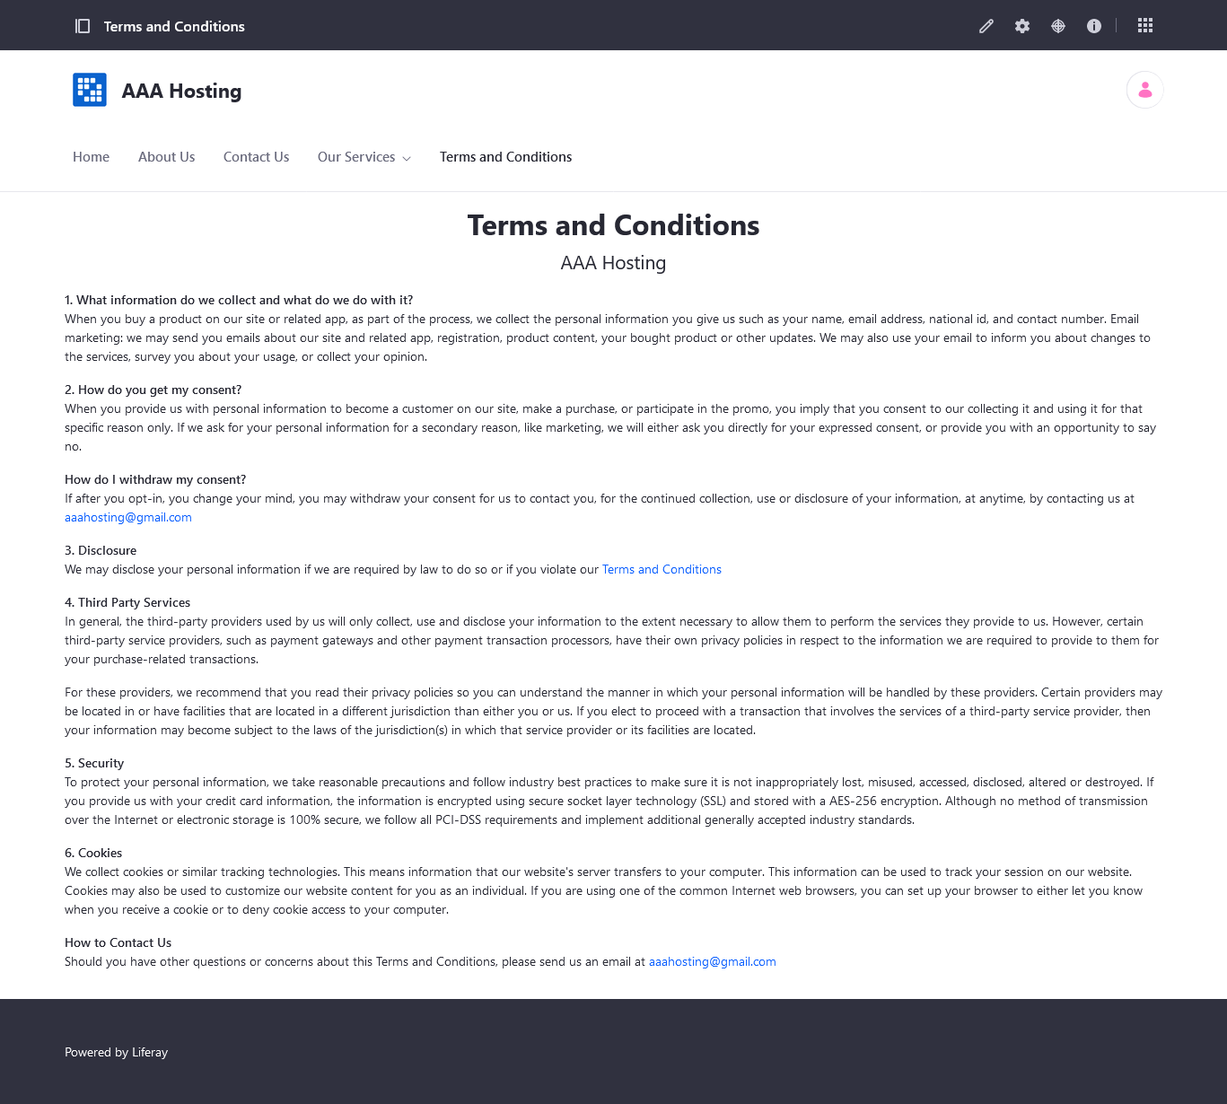
5. Developing Triple A portal
Contact Us
Terms and Conditions

Slide 17

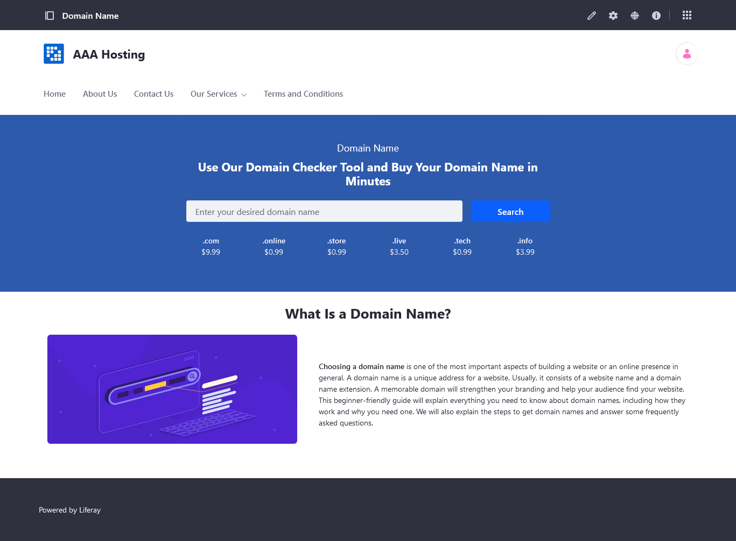
5. Developing Triple A portal
Our Services
Domain Name

Slide 18


5. Developing Triple A portal
Shared Hosting
Reseller Hosting

Slide 19


5. Developing Triple A portal
Cloud Hosting
VPS Hosting

Slide 20

5. Developing Triple A portal
Dedicated Hosting
Colocation Server Hosting

Slide 21
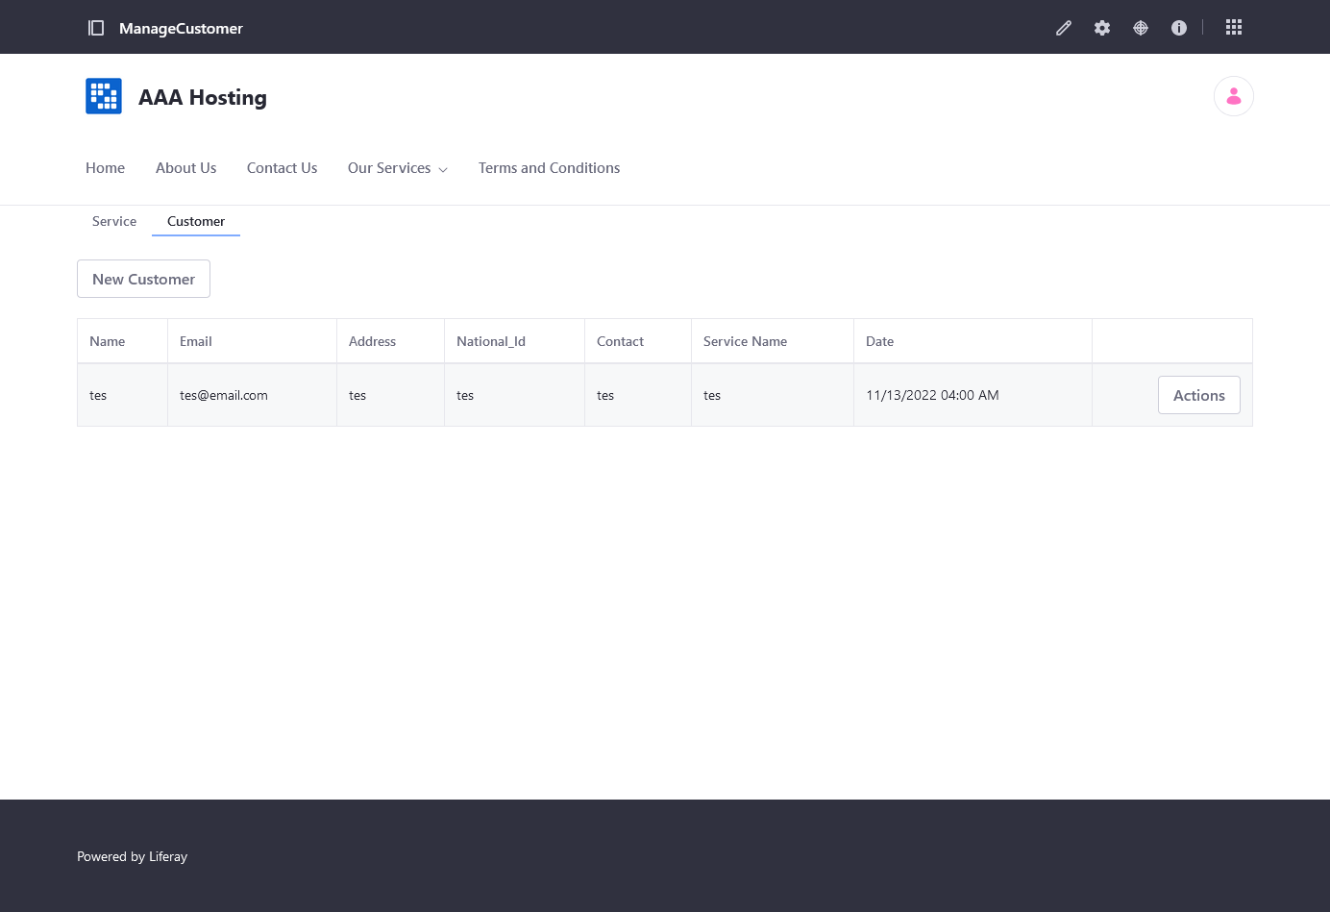
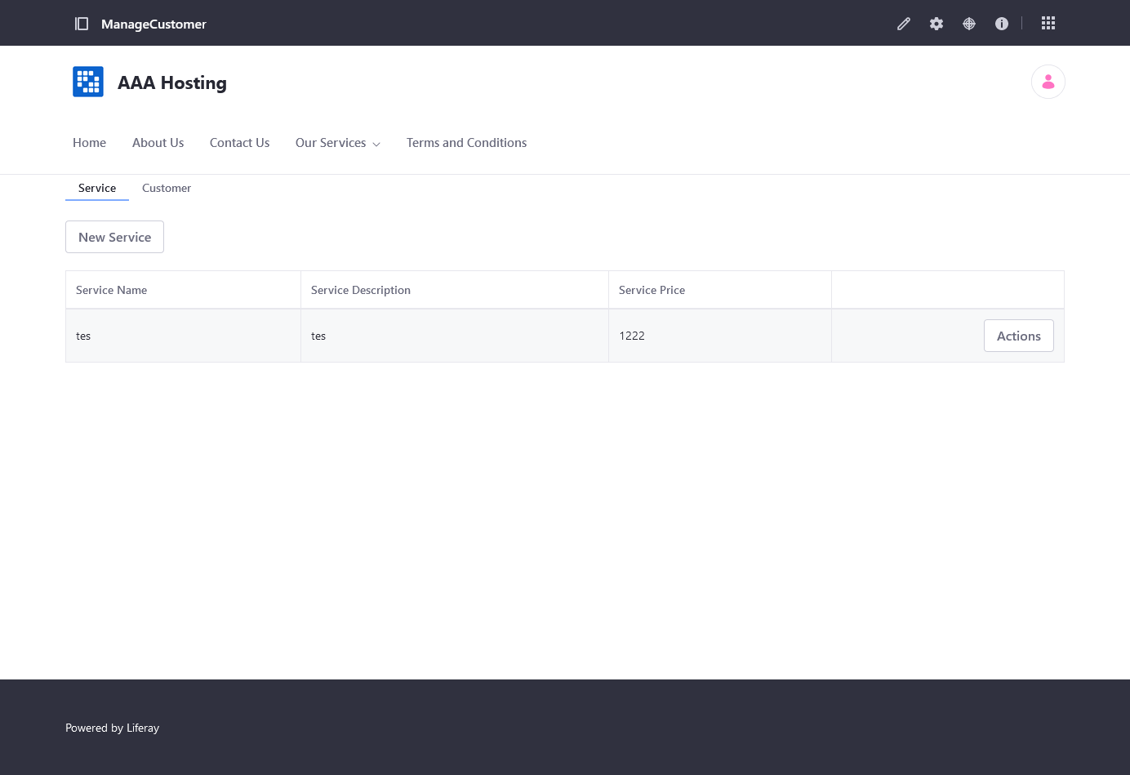
6. Customer Management Portlet

Slide 22
7. Design Patterns
Usage of Design Pattern in Software Development The use of design patterns in the Triple A Portlet is critical for maintaining neat and clean code. Even though the portlet has many layers of services and classes, not every design pattern will be useful when used by the portlet. We must use this information to determine the correct and optimal design pattern for the portlet. Because of the multiple layers of java classes, the portlet has already used the Factory pattern. And, because we don't use any filtering functions in the portlet, using the filter pattern is probably not the best pattern to adapt into it. Especially given how the portlet implements the method and the fact that there are multiple layers of java classes.
The consequences of design patterns which used in the project Using the factory pattern in a portlet or any OOP project will result in cleaner and tidier code, but if used excessively will result in a large number of required classes for main class implementation.

